Slide 1
Center for Substance Abuse Prevention (CSAP) Six and STAR Data
Heather Burnham, MPH, CHES
Prevention Program Manager
Office of Substance Abuse Prevention

Slide 2
Environmental
Examples:
Cop cars (perception of risk)
Green spaces (access)
Convenience stores (access)
Definition:
Establishes or changes written or ___________ community standards, codes, and ____________,
thereby influencing alcohol and other drug use by the general population
unwritten
attitudes

Slide 3
Community Based Process
Definition:
Provides ongoing networking ________ and technical assistance to community groups or agencies.
It encompasses neighborhood-based, grassroots empowerment models using action ________ and collaborative systems planning.
Examples?
activities
planning

Slide 4
Information Dissemination
Definition:
Provides knowledge and increases awareness
of the _______ and extent of alcohol and other drug use, abuse, and addiction, as well as their ______ on individuals, families, and communities;
provides knowledge and increases awareness
of available prevention and treatment programs and ________.
Characterized by one-way communication from source to audience, with limited contact between the two.
nature
effects
services

Slide 5
Differences?
How do you know if your activity is a
Community Based Process OR
Environmental one?
Of those three, which is the least effective?
Tabling and health fairs (not recommended)
Most often, which CSAP 6 is it?
If you have to table, how could it be done as another CSAP 6?
Which CSAP 6 do most of the strategies fit under?

Slide 6
SMART doc Strategies
A1. Low Enforcement
A2. Low Perceived Risk of Arrest/Legal Consequences
A3. Retail Access
A4. Social Access
A5. Individual Characteristics (DS)
A6. Community Awareness
R2. Retail Access
R3. Social Access
R4. Social Norms/Attitudes

Slide 7
Environmental vs Community Based Process
Establishes or changes written or unwritten community standards, codes, and attitudes,
thereby influencing alcohol and other drug use by the general population
Provides ongoing networking activities and TA to community groups or agencies.
It encompasses neighborhood-based, grassroots empowerment models
using action planning and collaborative systems planning

Slide 8
STAR Data
Community Based Process -- $1,153,000.35
Environmental --$180,801.88
Information Dissemination -- $95,068

Slide 9
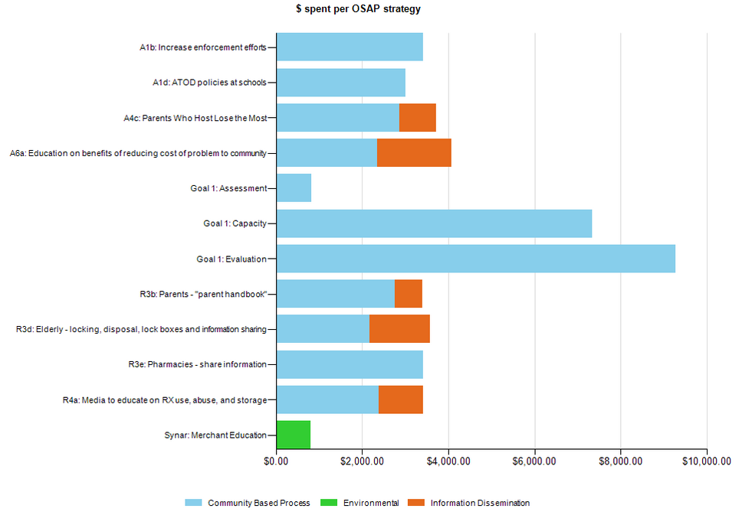
Provider Example

Slide 10
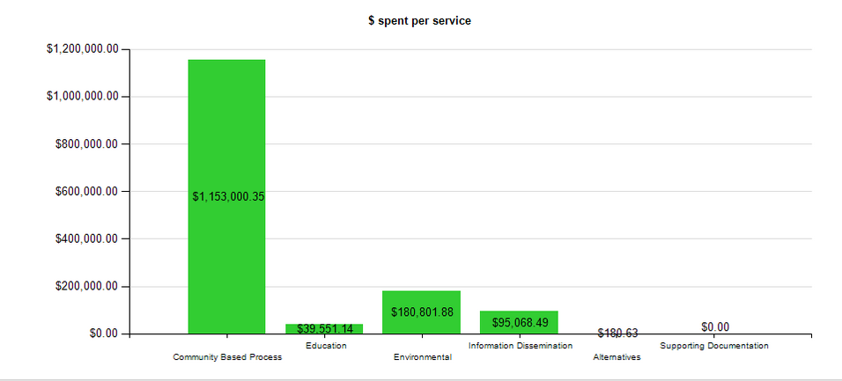
STAR CSAP 6 graph

Slide 11
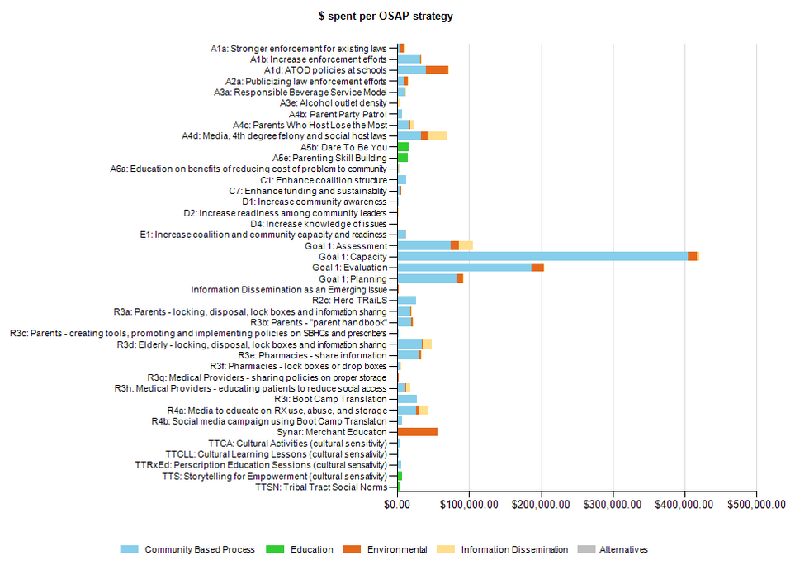

Slide 12
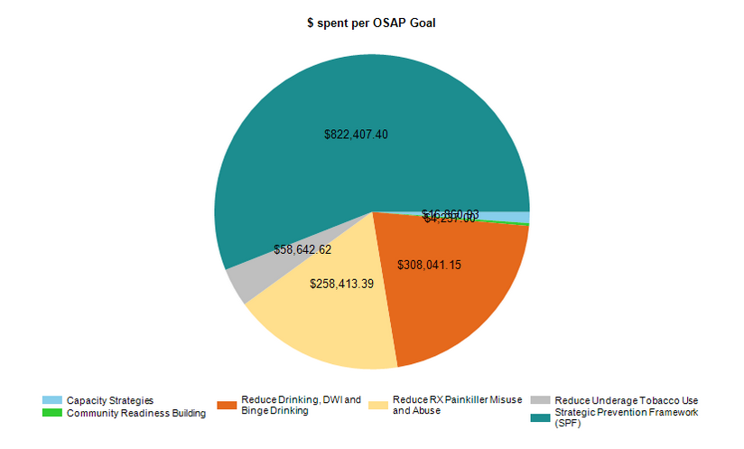
Strategy/SPF Pie Chart
BUT includes Evaluation and Assessment
(Three programs in SPF have been paid)

Slide 13
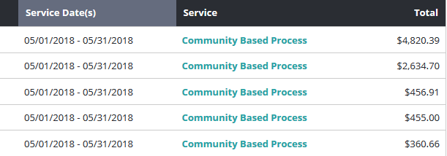
What does this mean?
What about the populations served?

